Slide 1
Chapter 14
Working with External Data in React

Slide 2
Objectives
Web Request
It’s React Time!
Getting the IP Address
Kicking the Visuals Up a Notch

Slide 3
Web Request 101
To get information about the user, here’s our HTTP request:
GET /user
Accept: application/json
For that request, here’s what the server might return:
200 OK
Content-Type: application/json
{
"name": "Kirupa",
"url": "http:https://www.kirupa.com"
}

Slide 4
Web Request 101
In JavaScript, the object that is responsible for allowing you to send and receive HTTP requests is the weirdly named XMLHttpRequest . This object allows you to do several things that are important to making web requests:
1. Send a request to a server
2. Check on the status of a request
3. Retrieve and parse the response from the request
4. Listen for the readystatechange event that helps you react to the status of your request

Slide 5
Web Request 101
Why Not Use Third-Party Libraries?
A bunch of third-party libraries wrap and simplify how you can work with the XMLHttpRequest object. Feel free to use them if you want, but using the XMLHttpRequest object directly isn’t very complicated, either. It’s only a few lines of code, and (compared to everything you’ve been learning in React) they’re some of the easiest lines of code you’ll encounter.

Slide 6
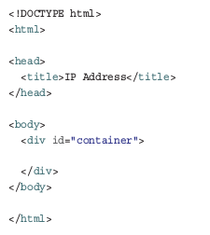
It’s React Time!
The first step is to create a new React app.
create-react-app ipaddress
Inside the public folder, create a new file called index.html . Add the following content into it

Slide 7
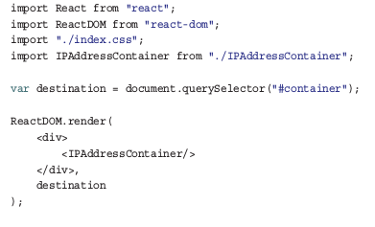
It’s React Time!
All we have going here is a div element named container . Next, go to your src folder and create a new file called index.js . Inside this file, add the following:

Slide 8
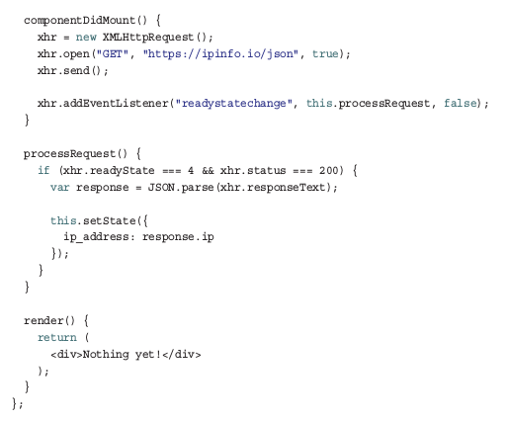
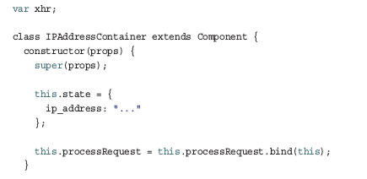
Getting the IP Address
The lines you just added don’t do a whole lot. They just print the words Nothing yet! to the screen.

Slide 9
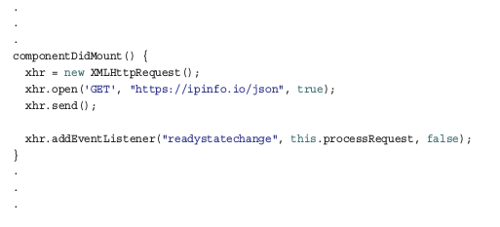
Getting the IP Address
Now we’re getting somewhere! When our component becomes active and the componentDidMount lifecycle method gets called, we make our HTTP request and send it off to the ipinfo.io web service:

Slide 10
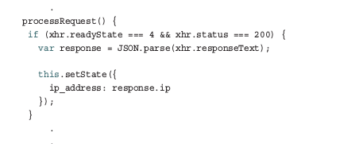

Getting the IP Address
When we hear a response back from the ipinfo service, we call the processRequest function to help us deal with the result:
Next, modify the render call to reference the IP address value stored by our state:

Slide 11
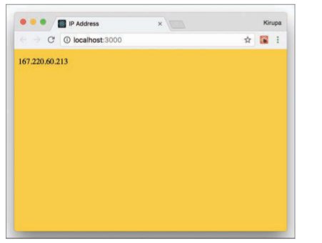
Getting the IP Address
If you preview your app in your browser, you should see an IP address displayed. If you need a reminder, you can preview your app by navigating into your ipaddress folder via your command line and entering npm start .

Slide 12
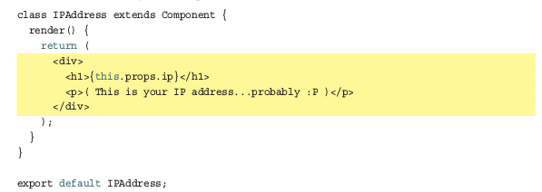
Kicking the Visuals Up a Notch
Defining a new component called IPAddress that will be responsible for displaying the additional text and ensuring that our IP address is visually formatted exactly the way we want.

Slide 13
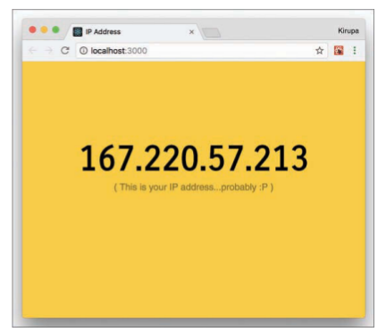
Kicking the Visuals Up a Notch
In our highlighted line, we call our IPAddress component, define a prop called ip , and set its value to the ip_address state variable. This is done to ensure that our IP address value travels all the way back to the IPAddress component’s render method, where it gets formatted and displayed.

Slide 14
Kicking the Visuals Up a Notch
Presentational vs. Container Components
Given what we’ve seen here so far, it seems like a good time to talk about a design choice that we’ve been indirectly following not just in this tutorial, but in other tutorials as well. In our React apps, we have been primarily dealing with two types of components:
1. Components that deal with how things look. These are better known as presentational components.
2. Components that perform some under-the-covers processing. Examples of this processing include routing, increasing a counter, fetching data via a HTTP request, and so on. You will see these components referred to as container components.

Slide 15
Conclusion
At this point, you’re probably wondering what was made special because of React.
All we really did here was use a boring old JavaScript API inside a component, hook up some events, and do the same state- and prop-related tasks you’ve done several times already.
Here’s the thing: You’ve already learned almost everything there is to learn about the basics of React. Going forward, nothing should surprise you.

